Slide 1
Global Electronics
Retail Analysis in the Electronics Industry to improve the sales performance and efficient inventory management.
Vijay Moses

Slide 2
The Company
Global Electronics, a leading retailer of consumer electronics, has provided with several datasets containing information about their customers, products, sales, stores, and currency exchange rates.
The company seeks to leverage this data to better understand their business and identify areas for improvement.

Slide 3
The Problem
As part of Global Electronics' data analytics team, I have tasked with conducting a comprehensive Exploratory Data Analysis (EDA) to uncover valuable insights from the company’s data.
The goal is to provide actionable recommendations that can enhance customer satisfaction, optimize operations, and drive overall business growth.

Slide 4
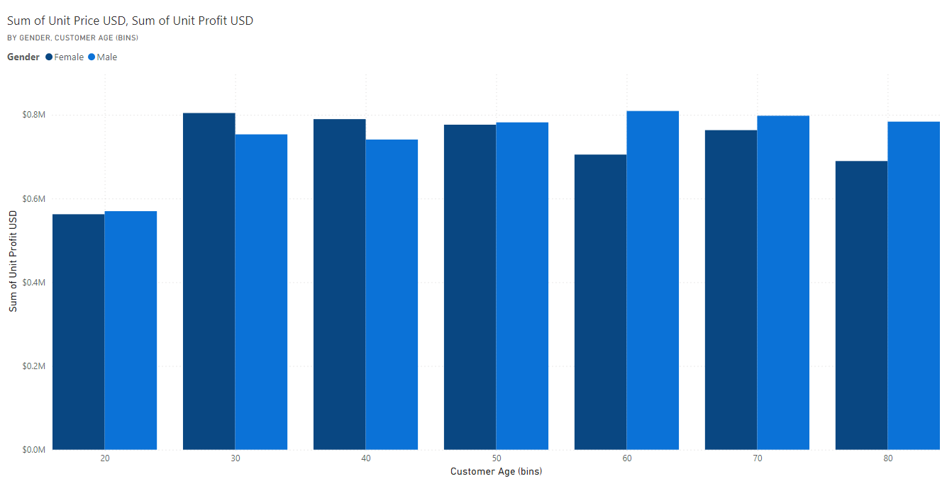
Customer Analysis
The Average age of customer is 56 years, and the total male customers are just 1.4% higher than female,
which is low difference.

Slide 5
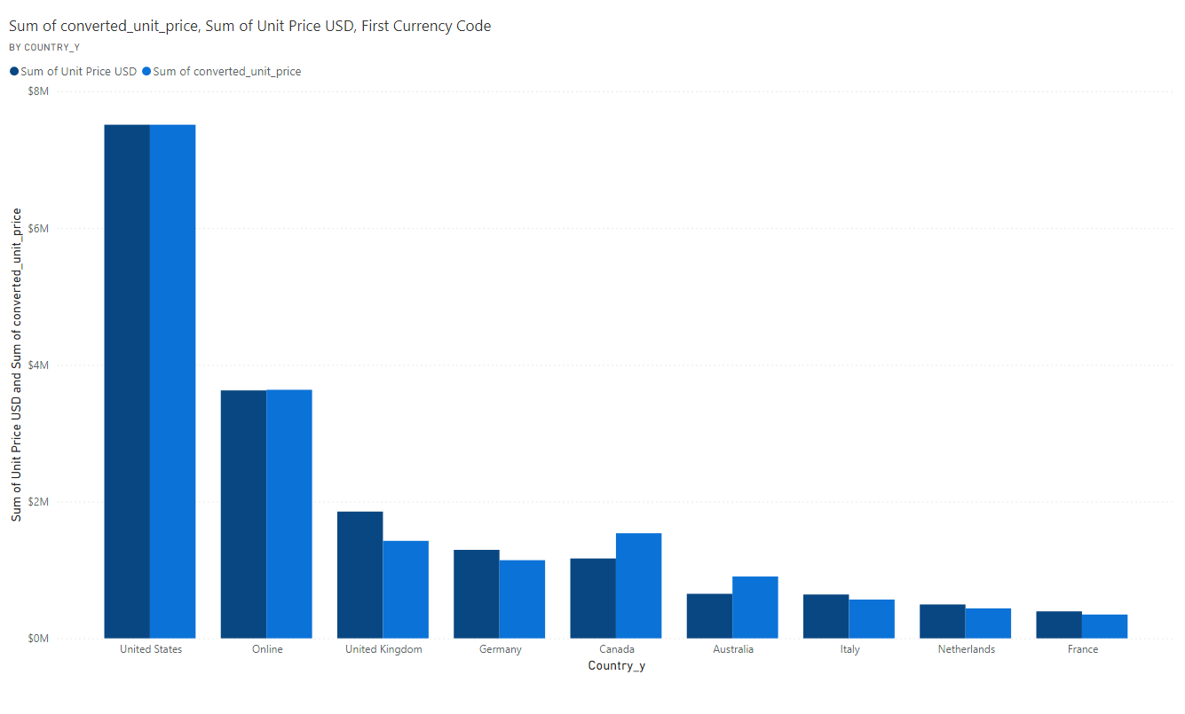
Most of the customers are from USA,2nd is online customers from all over the globe and the 3rd is UK.

Slide 6
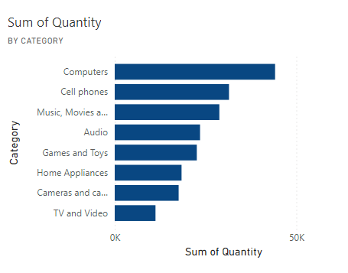
Product Analysis
Most preferred categories of products are ‘desktops’, ‘cell phones’ and ‘movies, music and audio’.
The most popular product category is Computers and the least is TV and video.

Slide 7
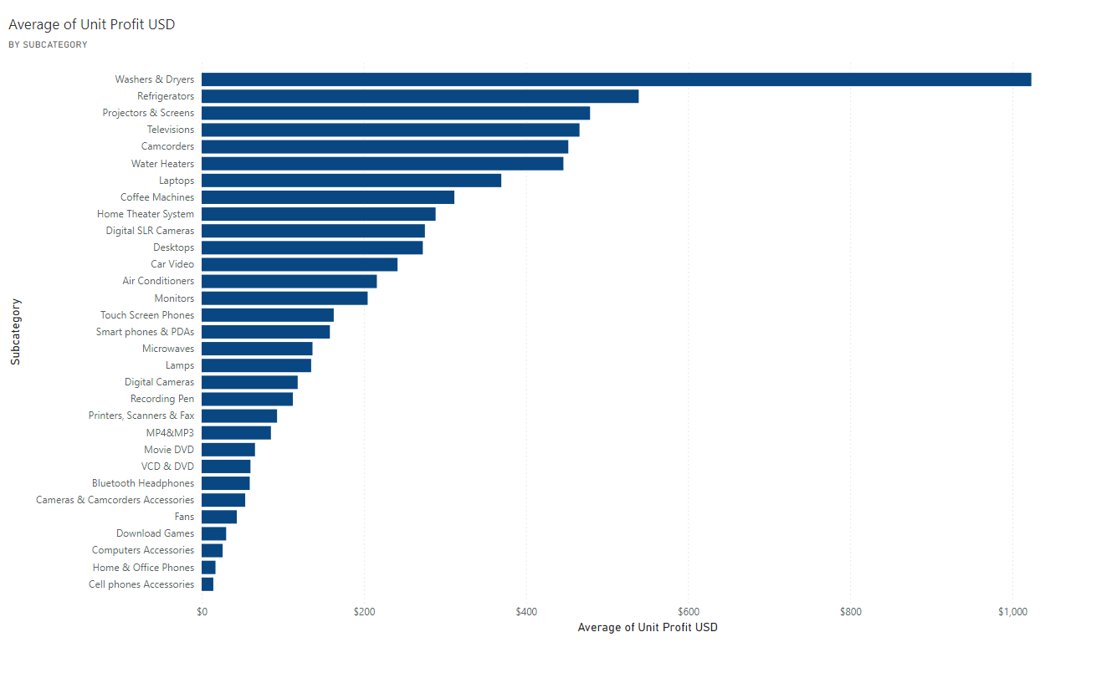
The product with high profit margin is washers & dryers and then refrigerators. But they are the 3rd least selling category(Home Appliances).

Slide 8
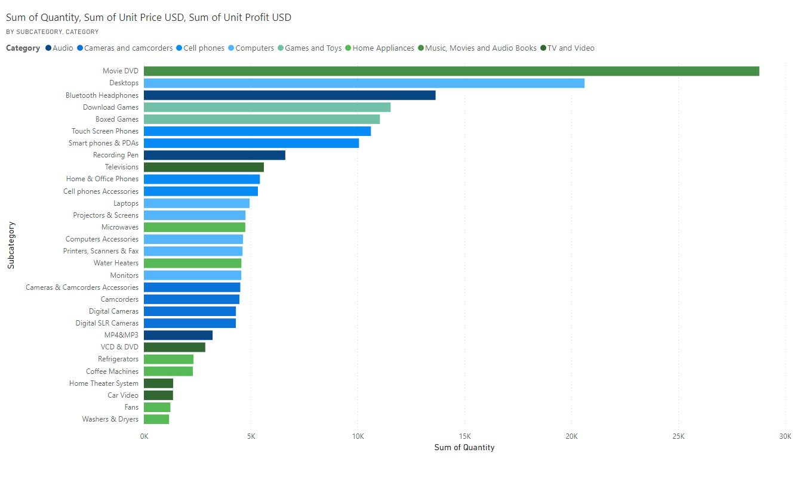
Most selling categories are computers, cellphones and Movies and in computers, desktops are top selling and in cellphones, touch screens are top selling and in movies, movie DVD are top selling.

Slide 9
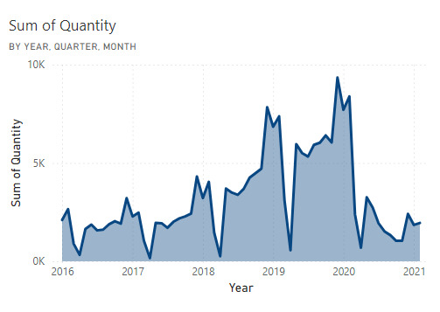
Sales Analysis
Summer holidays in 3rd quarters and winter holidays in 4th quarters leads to more sales in the start of that season until 1st quarter.

Slide 10
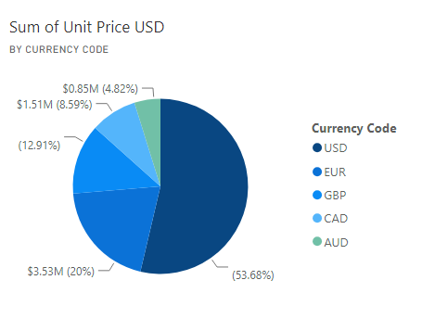
The company's top revenue is from USD and second is EUR and third is GBP.

Slide 11
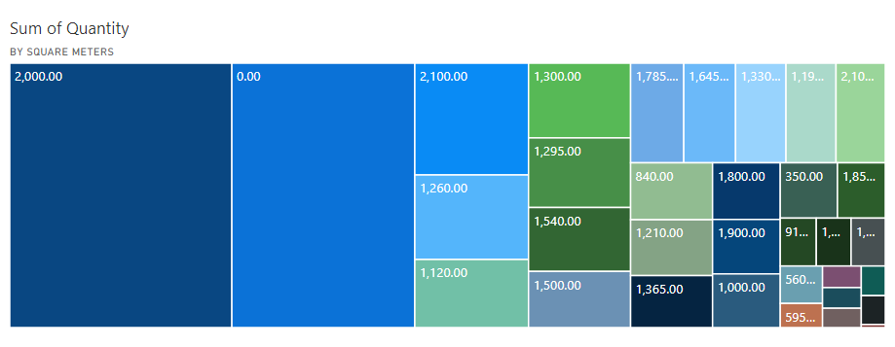
Store Analysis
Most of the sales are from the stores with size of 2000 square meters and the 2nd most sales are from online sales. High performing stores are stores from USA and UK.

Slide 12
Conclusion
Targeted Marketing: Since the average customer age is 56, consider running marketing campaigns that targets this age group. As the difference is small, ensure marketing efforts targets both genders.
Seasonal Promotions: Boost marketing efforts during summer and winter holidays (3rd and 4th quarters) when sales peak. Highlight top-performing products (PC desktops, Movie DVD and mobile phones).
Prioritize high-profit margin products: Despite being less popular, products like washers & dryers can contribute significantly more profits to revenue.
expanding sales to other currencies: While USD is dominant, expanding to EUR and GBP markets can diversify the pool of revenue.
Strengthen online sales : Since online sales are significantly high as well, investing in user-friendly websites, easy payment methods, and targeted online advertising will definitely improve more sales to the company.
Increase store sizes: Given that 2000-square-meter stores perform well, it is recommended in opening more stores of same size. Which might drive more sales as well.

Slide 13
Thank You

